Slide 1

Dilated cardiomyopathies: cardio-immuno-genetics
Refereeravond, Cardiologie Zuid
Stephane Heymans
Dep. of Cardiology, CARIM, Maastricht University Medical Centre, Netherlands
www.hfresearch.eu
Notes:
During my talk I hope to convince you that the development of a non-ischemic, non-valvular CMP results from the interaction between genetics and acquired diseases.

Slide 2
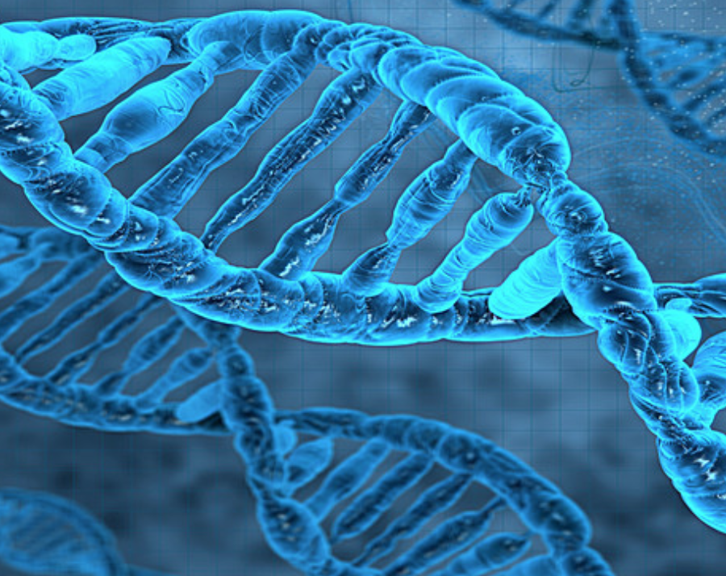

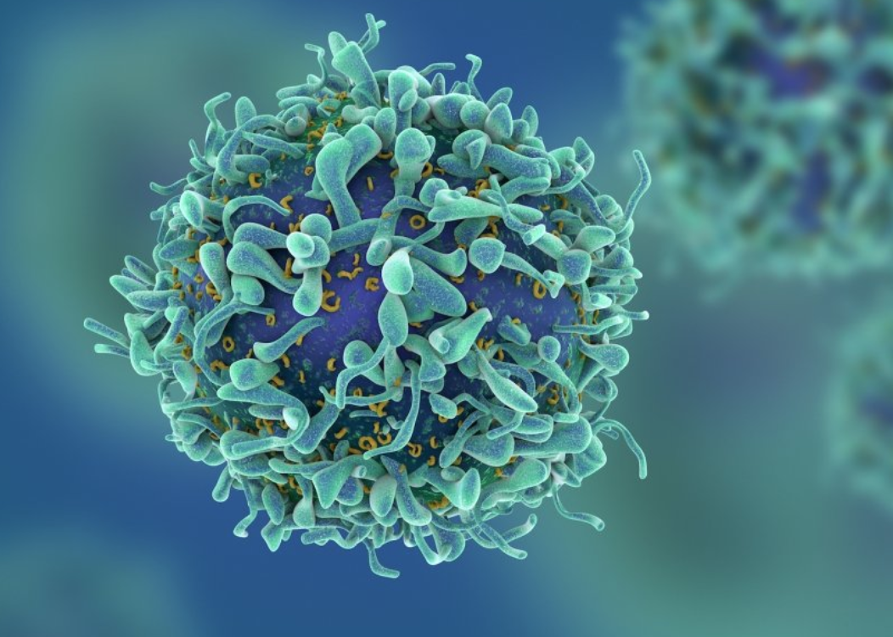
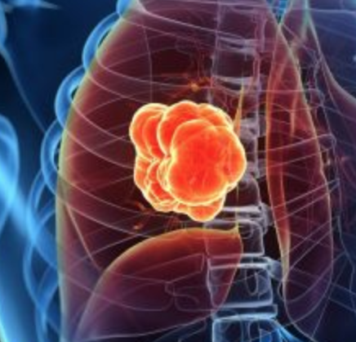
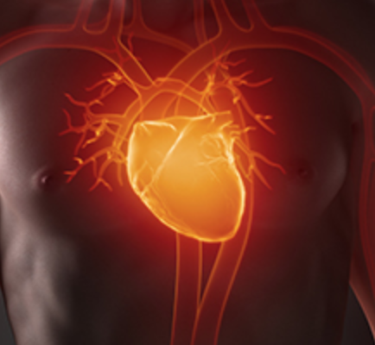
Dilated cardiomyopathy
Heart failure with reduced EF, Europe and US: 13 million!
DCM: 1/3 of HFrEF → 4 million.
30 % pathogenic variant, 25 % increased cardiac inflammation
Cancer
Dilated CMP
2/3: (Epi)genetics/ageing
1/3: Environmental
Obesity (1:5)
Alcohol (1:5)
Infections (1:5)
(Smoking (1:3))
….
Notes:
In Europe and US, around 13milion people are living with heart failure.
Approximately 1/3 is due to a dilated cardiomyopathy: 2 milion people live with a dilated cardiomyopathy.
Those people are younger, median age is approx 50 years: otherwise healthy, socially and economically active adults.
The perception that cancer is juse fate, and heart failure is due to an healthy life stile is wrong.
Both cancer and heart failure surpisingly almost share the same risk factors. 2/3 is due to genetic, epigenetics and ageing, and 1/3 is related to to environmental factors, including smoking, obesity, alcohol intake and infectiosn.

Slide 3
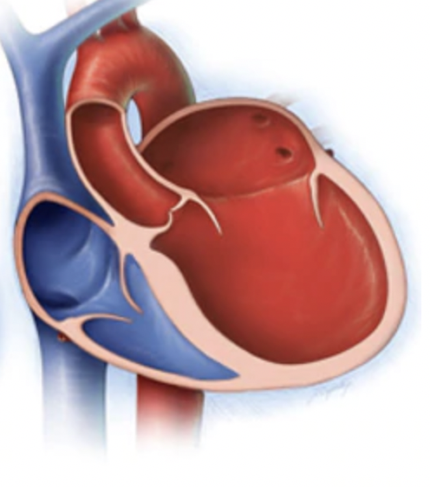


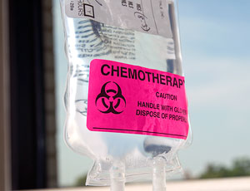
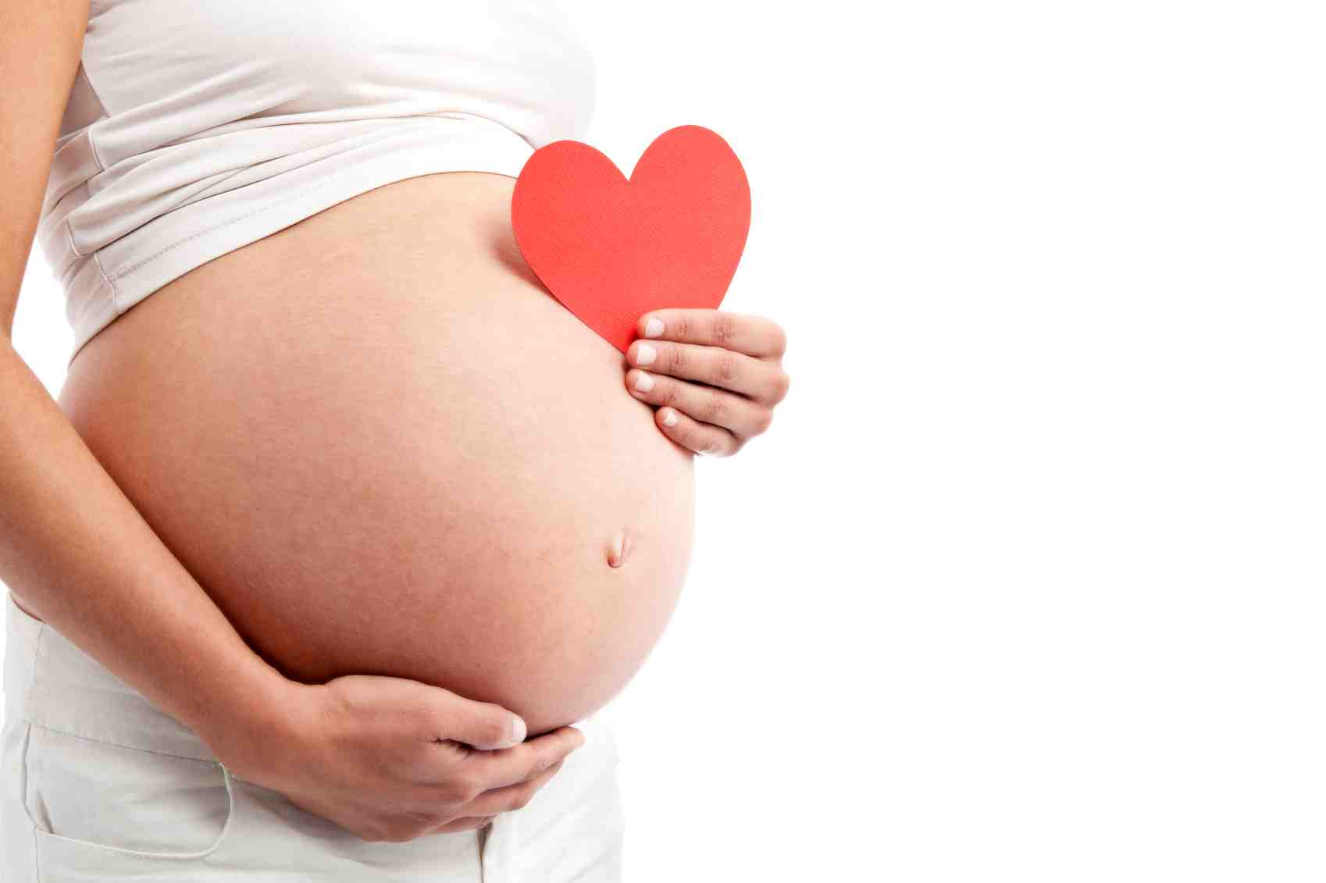

Combination of imaging + genetic + disease modifiers/ acquired hits → phenotype + outcome
Infection (virus)
(Auto)-immunity.
(Epi)genetic / familial
Chemo/ethyl
Monogenic
Polygenic (risk score)!
Pregnancy
Co-morbidities
Heymans et al., Lancet, 2023; Sep 16;402(10406):998-1011

Slide 4
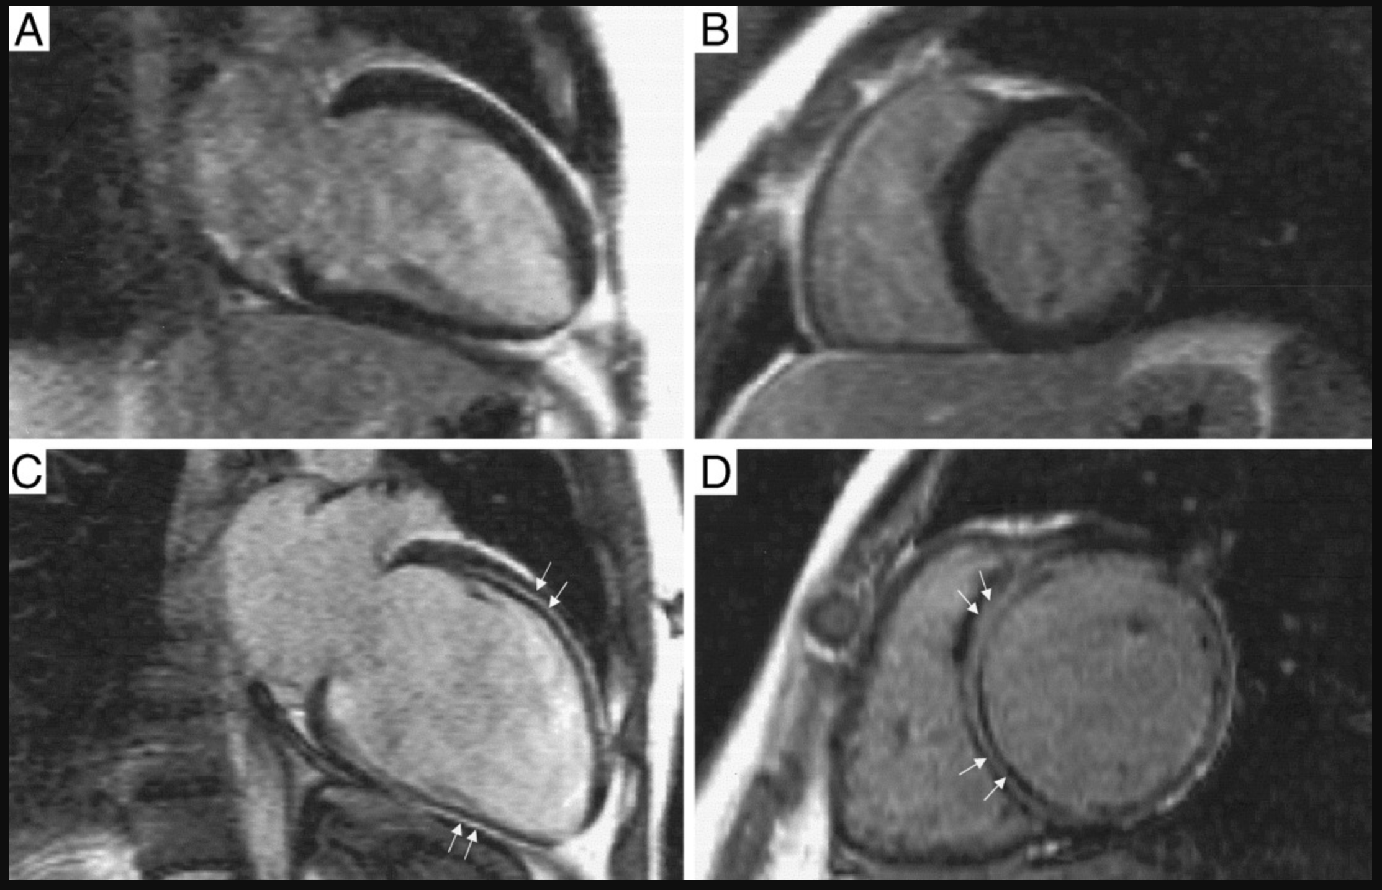
Dilated CMP: increased late gadolinium fibrosis at imaging predictive of prognosis

Slide 5
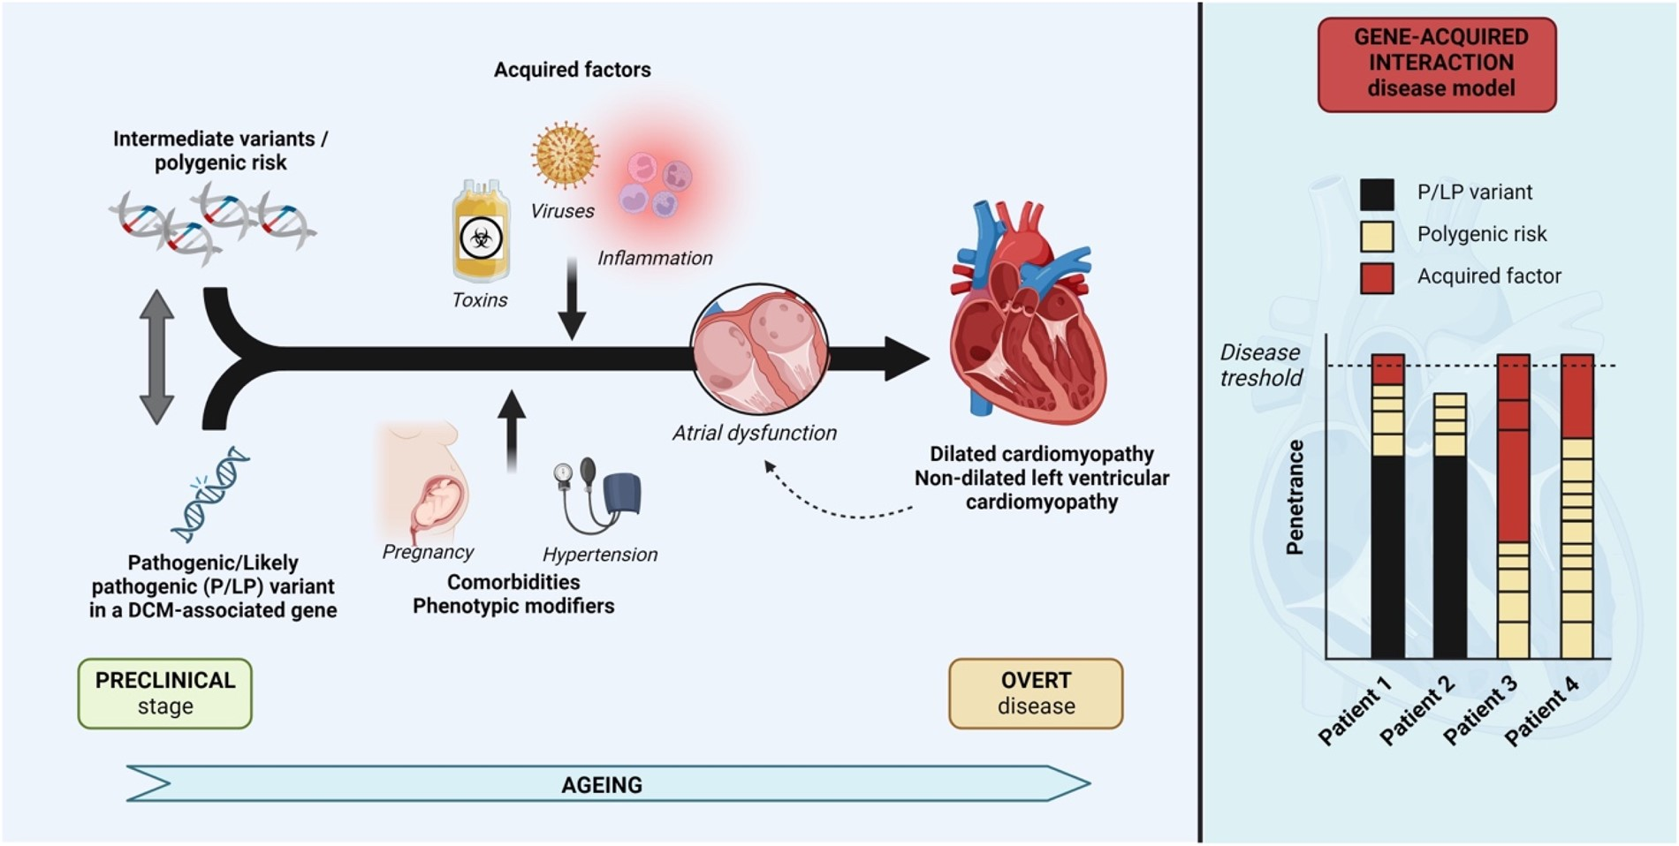
Notes:
Figure 1 The clinical presentation and outcome of DCM or NDLVC are determined by the common co-existence of both genetic -mono and polygenic risk- and acquired factors (such as toxins, viruses, and auto-immune diseases), disease modifiers (such as pregnancy), or co-morbidities (diabetes, hypertension, endocrinopathies, and renal, hepatic or (micro)-vascular disease).
Unless provided in the caption above, the following copyright applies to the content of this slide: Published by Oxford University Press on behalf of the European Society of Cardiology 2023.This article is published and distributed under the terms of the Oxford University Press, Standard Journals Publication Model (https://academic.oup.com/pages/standard-publication-reuse-rights)

Slide 6
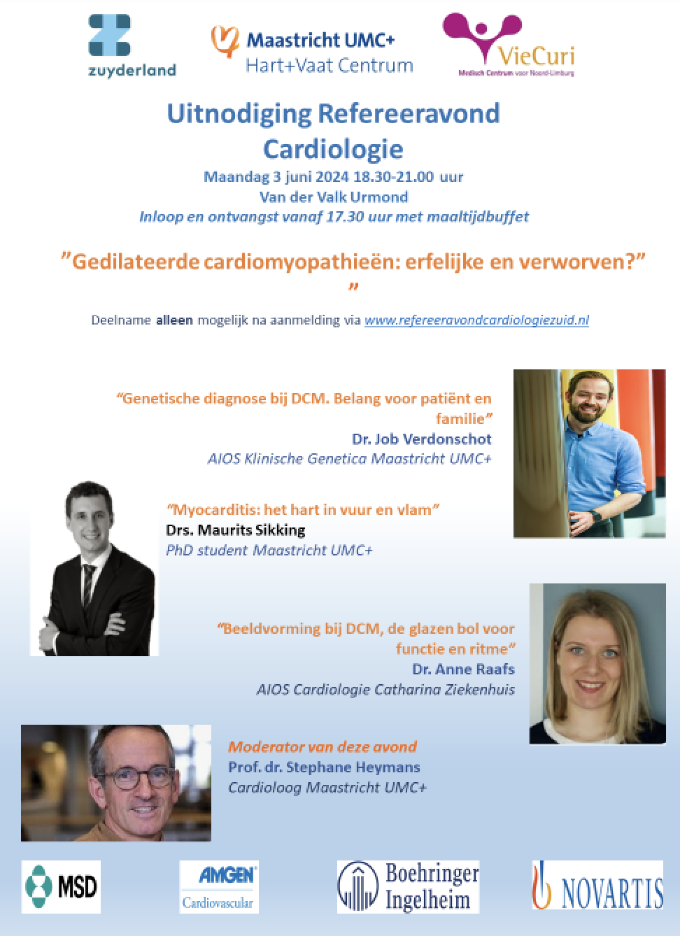

Slide 7
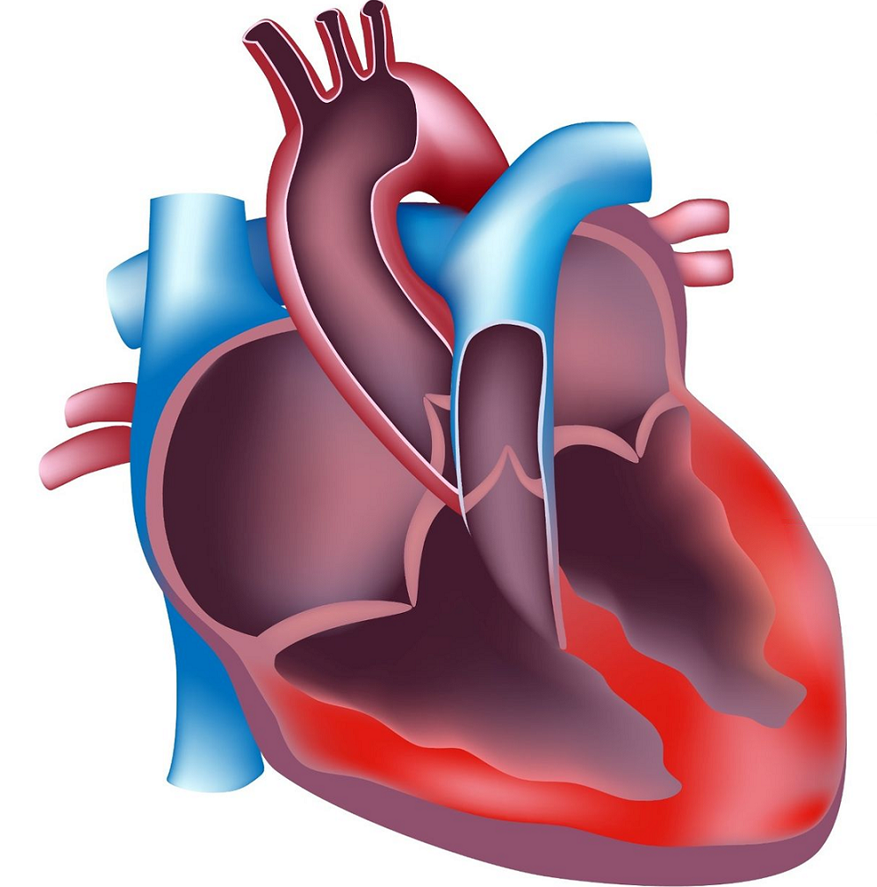
Cardiomyopathies: multidisciplinary CMP program
Deep clinical phenotyping!
Genetics (90 %)!
Cardiac MRI at baseline!
Cardiac biopsies (inflammation/storage/metabolic)
Multidisciplinary counselling
  Immunology
  Genetics
  Pathology
  Imaging
Prospective cohort & biobank (> 1800 pts, FU 17 yrs since 2005)
Collaborations (inter)nationally, academics & industry
(Maastricht Biobank: plasma, serum, buffy coat, PBMC, left over cardiac biopsies)
Cardio
logy
Microbiology
(Viruses)
Pathology
Immuno-logy
Genetics
Notes:
To go for refined diagnosis and a targeted therapy, one need to aim for a multidiscipliany clinical care programme, including deep clinical phenotyping,

Slide 8
Cardiomyopathies: genetics & second hits
Second hits: gene-environmental interactions
Dilated cardiomyopathy
  Case of peripartum CMP
  Case of myocarditis → CMP
  Case of autoimmune disease - CMP
Treatment: future?
Why me? Diagnosis!
ICD indication (LMNA, RBM20, PLN)
Family members: early diagnosis & treatment

Slide 9
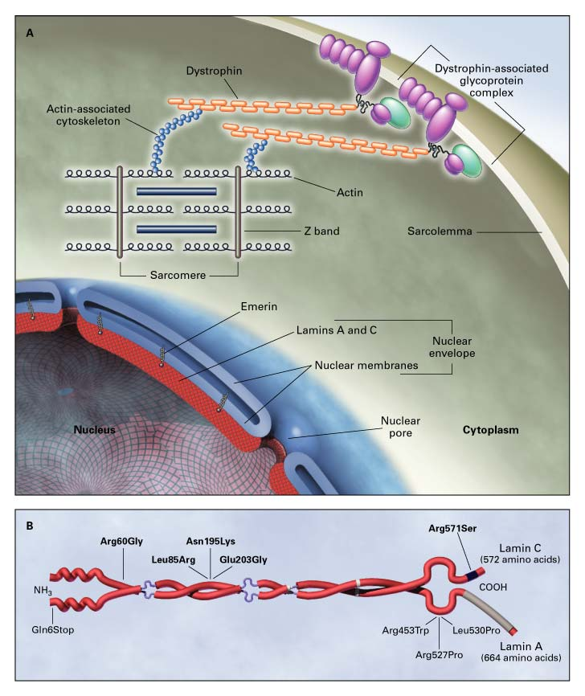

Dilated cardiomyopathies: mono-genic mutations in up to 1/3
Cardio-genetics
  Gene mutation: 35 % of familial, 15 % non-familial
  7 genes → 95 % of pathogenic gene mutations (TTN, MYH7, LMNA, RBM20, TNNT2, FLNC)
  18 genes: significant association with DCM
  BAG3, DES, DSP, FLNC, LMNA, MYH7, PLN, RBM20, SCN5A, TNNC1, TNNT2, TTN, ACTC1, ACTN2, JPH2, NEXN, TNNI3, TPM1, VCL
Sarcomeric proteins
Nuclear envelop
RNA binding protein
Cell membrane
Signalling
Sophie Stroeks
Stroeks S. Genet Med. 2021 Nov;23(11):2186-2193
Notes:
Genetic counseling and testing is therefore recomended in all patients with both acquired or familal dilated cardiomyopathies

Slide 10
Cardiomyopathies: genetics
Second hits: gene-environmental interactions
Dilated cardiomyopathy
  Case of peripartum CMP
  Case of myocarditis → CMP
  Case of autoimmune disease - CMP
Treatment: future?
Why me? Diagnosis!
ICD indication (LMNA, RBM20, PLN)
Family members: early diagnosis & treatment

Slide 11
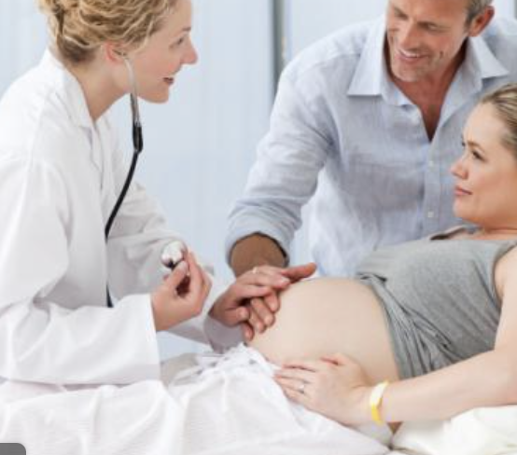
Case of peripartum cardiomyopathy:
Pregnancy = disease modifier
36 yrs female
EF 15 % + AFib
TTNtv mother
Pregnancy
Titin truncating
mutation
Notes:
Some cases:

Slide 12
Dilated CMP: increased late gadolinium fibrosis at imaging predictive of prognosis

Slide 13
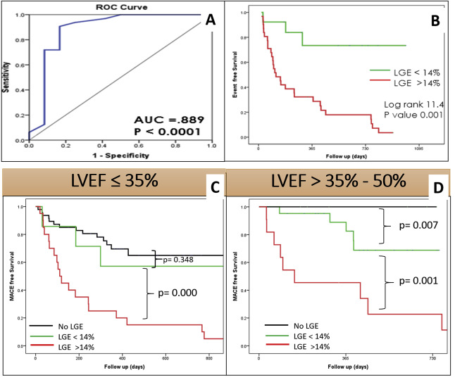
Fibrosis @ CMR predictive of worse outcome

Slide 14
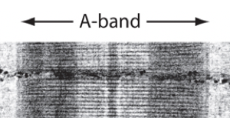
Titin gene (truncating) mutations in A-band: 1/3 of all mono-genic DCM
Largest protein, scaffold.
Truncating mutations in the A-band = pathogenic!
1/3 of all gene mutations in DCM
Approx. 10 % of all DCM >< 0,1-1 % in healthy controls
Tayal U. J Am Coll Cardiol. 2017 Oct 31;70(18):2264-2274
Notes:
Titin is the largest protein in the body. It is the scaffold of the contractile elements in the cardiomyocytes, spanning all over the sarcomer.
Variations leading to a stop codon –truncating mutations are the main cause of a

Slide 15
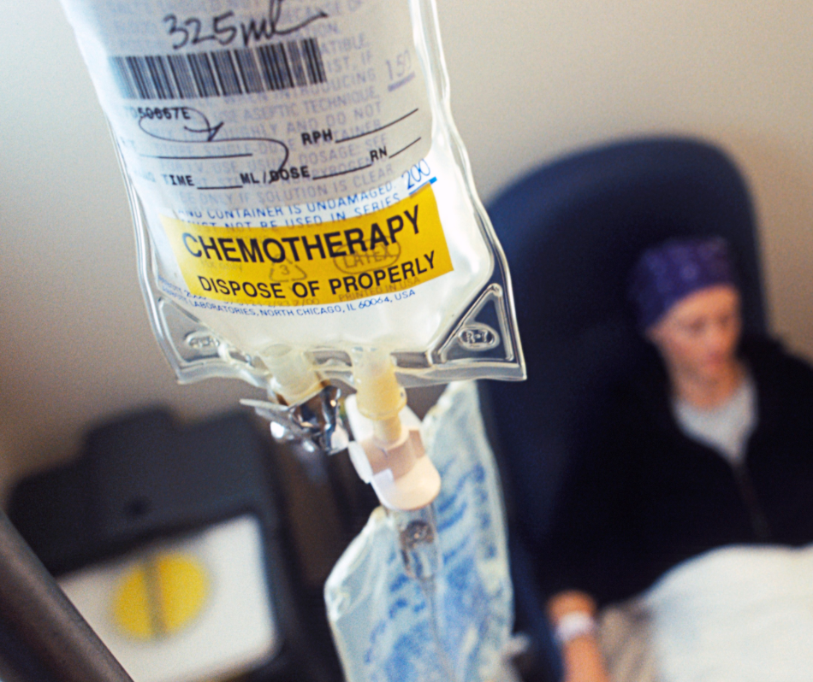
Titin-tv mutations: 8-15 % prevalence in “acquired CMP” (<1% control)
Alcoholic CMP!
Peripartum CMP!
Chemotherapy CMP!
Early and/or familial atrial fibrillation!
Acute myocarditis!
SECOND HIT : gene-environmental
Titin truncating muation
Acquired disease/second hits
Garcia-Pavia P. et al Circulation. 2019 Apr 16.
Tayal et al. Circulation, 2022, Oct 11;146(15):1123-1134.
Ware JS et al. N Engl J Med 2016;374:233-241.
Ware JS et al. Am Coll Cardiol. 2018 May 22;71(20):2293-2302.

Slide 16
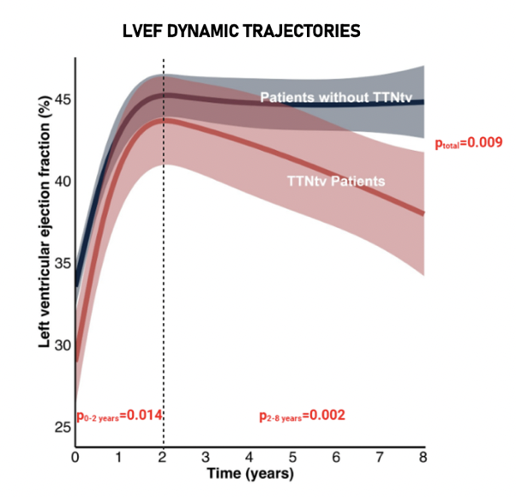

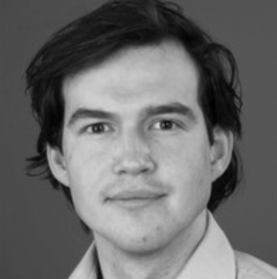

Titin-tv DCM: initial improvement but decline > 2yrs despite SoC
Non-TTN
Michiel Henkens
TTN tv
Henkens M. Circ HF, 2022; Aug;15(8):e009352
Notes:
Taking care of those patients, most of them being refered by regional hospitals, we look for the different causes.
Genetic mutations are the most frequents causes.
But also viruses, auto-immunity, toxicity (alcoh chemotherapy), rythmdisturbances.

Slide 17
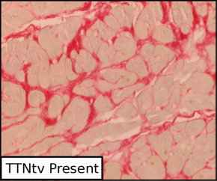
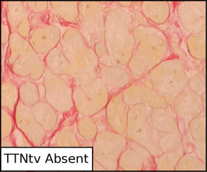
TTNtv DCM have more fibrosis → arrhythmias!
Well treatable: 50 % reversed remodelling
  BUT BIPHASIC: DETERIORATION AFTER 2 YRS
Life threatening ventricular arrhythmias + atrial fibrillation at long-term!
Increased fibrosis and mitochondrial oxidative stress!
  Histological @ biopsies
  RNA sequencing @ biopsies
TTNtv mutation
No TTN mutation
Verdonschot JA., et al, Eur. Heart J, 2018; Mar 7;39(10):864-873

Slide 18
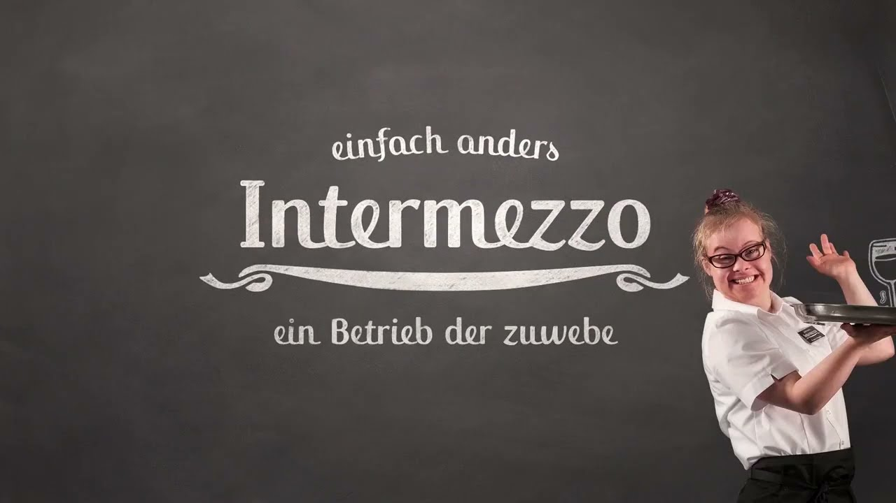
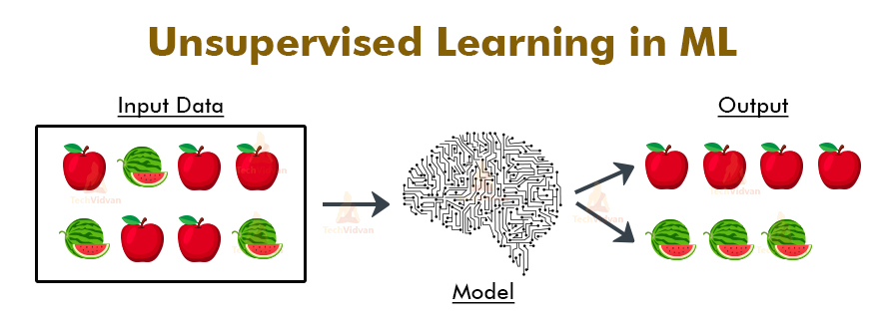
Phenoclustering of DCM
Unsupervised machine learning→ supervised random forest tree analysis in n=795 DCM patients

Slide 19
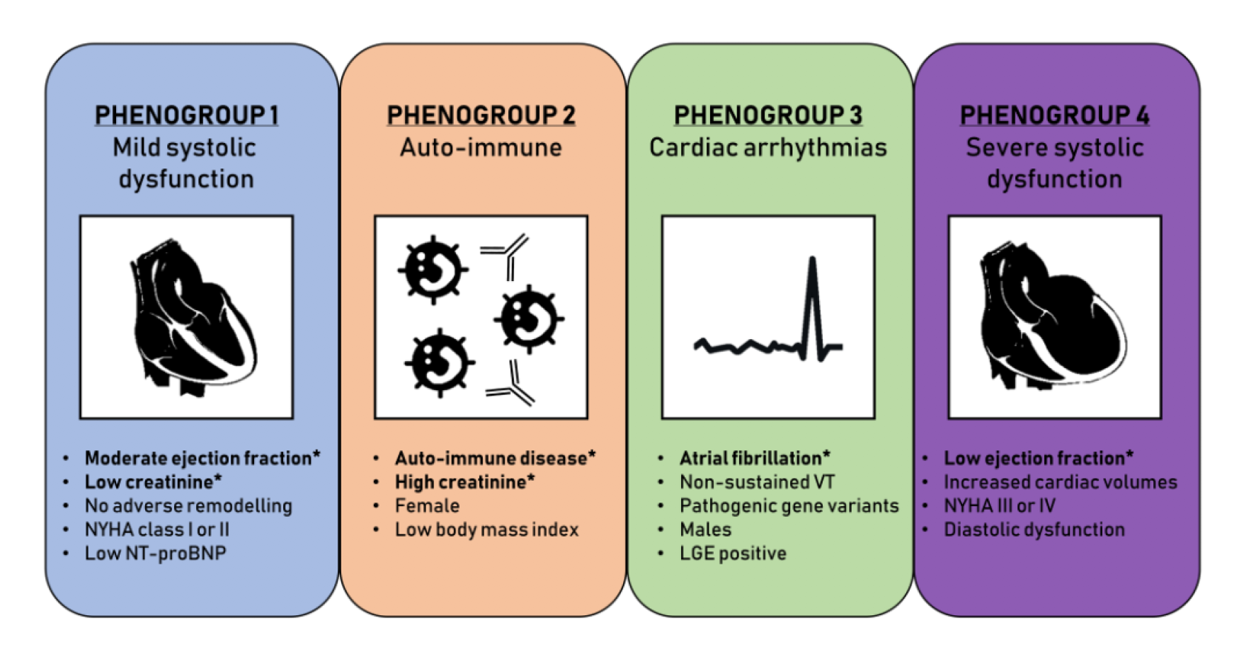

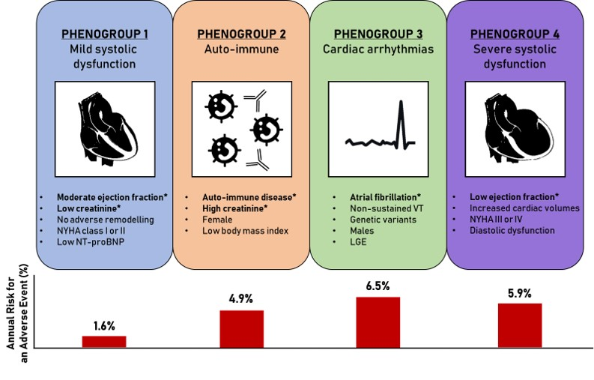

Phenoclustering: clinics + genetics + imaging n=795 DCM patients (Maastricht)
Auto-immune!
Inflammation
Gene mutations!
Fibrosis
Mild dysfunction
Severe dysfunction
Job Verdonschot
Michiel Henkens
Mark Hazebroek
Worse outcome
n=795 DCM patients. Unsupervised machine learning 47 parameters + random forest tree analysis (supervised)
Verdonschot JA. Eur Heart J. 2021 Jan 7;42(2):162-174.

Slide 20
Verdonschot JA. Eur Heart J. 2021 Jan 7;42(2):162-174.

Slide 21




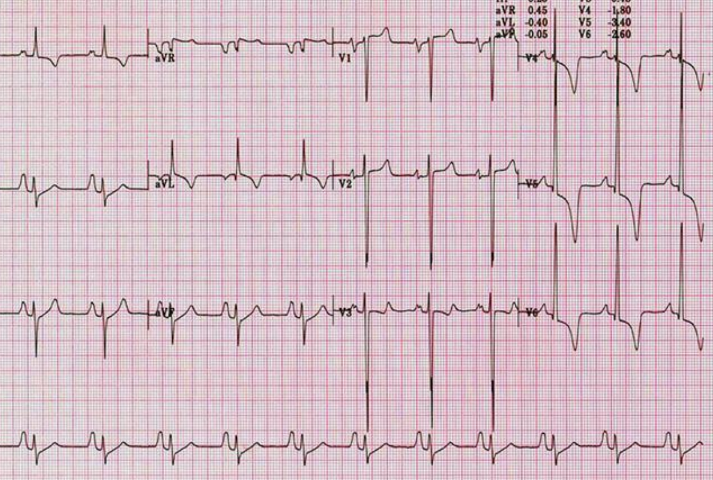
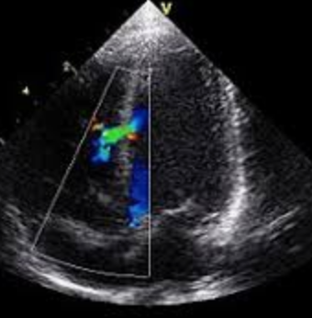
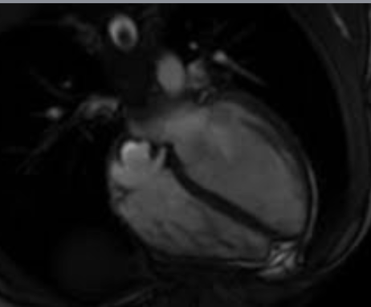
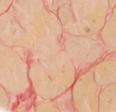
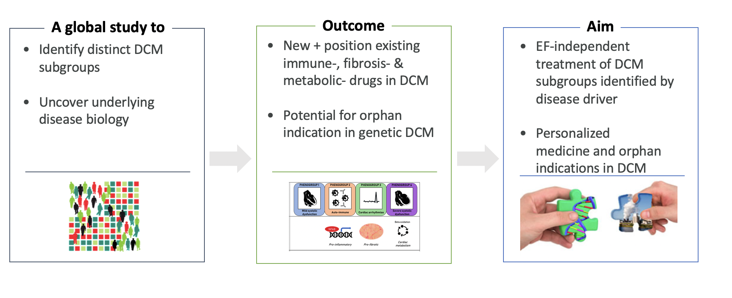
DCM-Precise (phenomics, ECG, imaging, WGS, RNA seq)
1/3 of all HFrEF patients
n>1600
Median FU: 7 yrs
Deep Clinical Phenotyping
Genetic testing (n>900)
Whole exome seq (n=450)
ECG ARTEC
AI analysis
Echocardiography
Strain, Echo-AI
Cardiac MRI
Strain, AI
Notes:
Cardiac transcriptomics data will be explored for inherent subgrouping structure to identify molecular strata within the HF patient population (unbiased data-driven and hypothesis-driven approaches, including validation of AZ previous findings);
In silico cell-type deconvolution approaches will be applied to the bulk-tissue cardiac transcriptomics data to identify cell type-specific signatures;
Exploration of clinical variables and molecular data associations and inter-correlations.

Slide 22
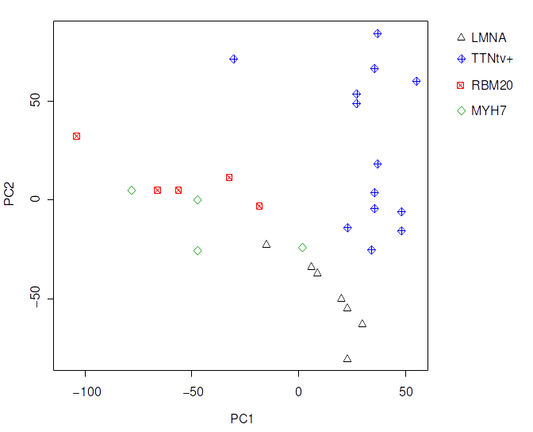
Distinct cardiac RNA Clusters in Titin and LaminA/C DCM
TITIN tv 1 (responsers)
Job Verdonschot
TITIN tv 2 (non-
Responders)
Other genetic
DCM
Lamin A/C
Verdonschot JA, et all. Circulation. 2020 Sep 22;142(12):1230-1232.

Slide 23
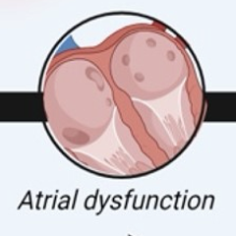
Notes:
Figure 1 The clinical presentation and outcome of DCM or NDLVC are determined by the common co-existence of both genetic -mono and polygenic risk- and acquired factors (such as toxins, viruses, and auto-immune diseases), disease modifiers (such as pregnancy), or co-morbidities (diabetes, hypertension, endocrinopathies, and renal, hepatic or (micro)-vascular disease).
Unless provided in the caption above, the following copyright applies to the content of this slide: Published by Oxford University Press on behalf of the European Society of Cardiology 2023.This article is published and distributed under the terms of the Oxford University Press, Standard Journals Publication Model (https://academic.oup.com/pages/standard-publication-reuse-rights)

Slide 24
More value of CMR in DCM
Structural abnormalities
DD ACM (ARVC), DCM, HCM
Prognosis and therapy
Ejection fraction
Fibrosis: LGE
  ICD indication if EF <= 35 %
Global longitudinal strain of LV
Conduit strain of left atrium

Slide 25
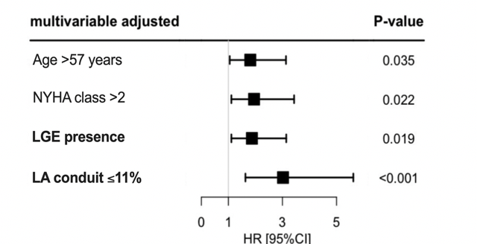
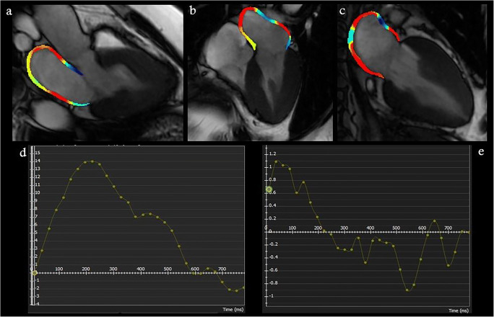
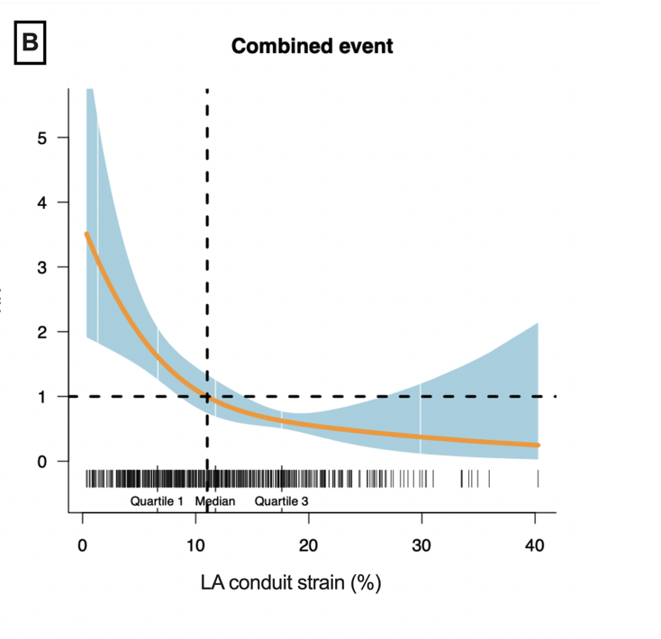

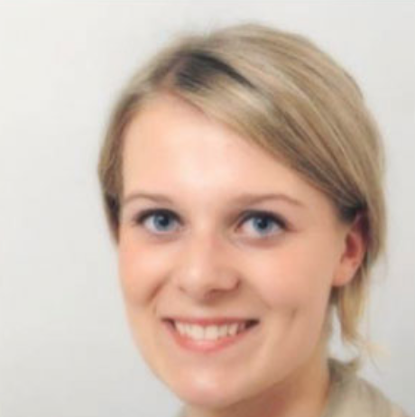
Left atrial strain predicts DCM outcome!
n=488 DCM pts
Anne Raafs
Raafs A. JACC CVI, 2022: 15(6):1015-1026
Notes:
The atrium as an early sensor of cardiac dysfunction is also

Slide 26
Cardiomyopathies: genetics & second hit
Second hits: gene-environmental interactions
Dilated cardiomyopathy
  Case of peripartum CMP
  Case of myocarditis → CMP
  Case of autoimmune disease - CMP
Treatment: future?
Why me? Diagnosis!
ICD indication (LMNA, RBM20, PLN)
Family members: early diagnosis & treatment

Slide 27
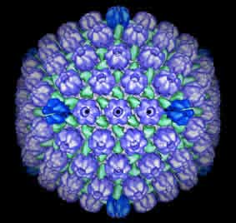
Viruses → myocarditis & DCM
Male 28 yrs
EF 35 %, DCM
Recurrent myocarditis
Cardiac biopsy:
Infection (virus)
Increased CD8-
Cytotoxic T-cells
DSP-mutation
Hazebroek M. JACC. 2015 Sep 22;66(12):1313-23.
Notes:
Taking care of those patients, most of them being refered by regional hospitals, we look for the different causes.
Genetic mutations are the most frequents causes.
But also viruses, auto-immunity, toxicity (alcoh chemotherapy), rythmdisturbances.

Slide 28
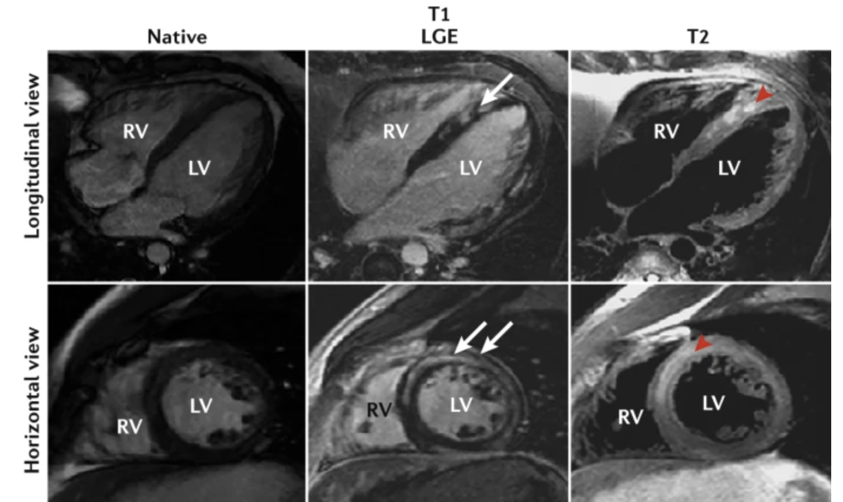
CMR: increased T1, T2 and LGE;
Inflammation & fibrosis!

Slide 29
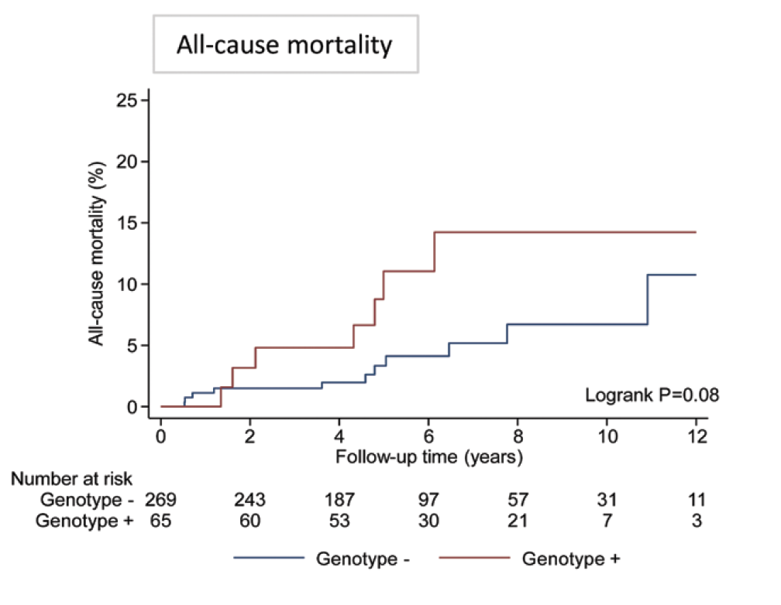

Genetic architecture in acute myocarditis
Acute myocarditis n=336 vs. Controls, n=1053 (genotyping)
Pathogenetic variants (mainly TTN and DSP) in 8 %!
  --> worse outcome
  EF decreased: Titin-tv in 7 %
  EF normal/arrhythmias: Desmoplakin in 4 %
Lota A. et al. Circulation, 2022 Oct 11;146(15):1123-1134

Slide 30
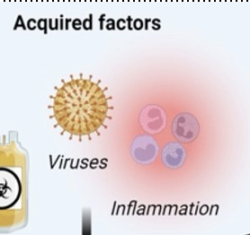
Notes:
Figure 1 The clinical presentation and outcome of DCM or NDLVC are determined by the common co-existence of both genetic -mono and polygenic risk- and acquired factors (such as toxins, viruses, and auto-immune diseases), disease modifiers (such as pregnancy), or co-morbidities (diabetes, hypertension, endocrinopathies, and renal, hepatic or (micro)-vascular disease).
Unless provided in the caption above, the following copyright applies to the content of this slide: Published by Oxford University Press on behalf of the European Society of Cardiology 2023.This article is published and distributed under the terms of the Oxford University Press, Standard Journals Publication Model (https://academic.oup.com/pages/standard-publication-reuse-rights)

Slide 31
Cardiomyopathies: genetics and second hit
Second hits: gene-environmental interactions
Hypertrophic cardiomyopathy
Arrhythmogenic cardiomyopathy
Dilated cardiomyopathy
  Case of peripartum CMP
  Case of myocarditis → CMP
  Case of auto-immune → CMP
Treatment: future?
Why me? Diagnosis!
ICD indication (LMNA, RBM20, PLN)
Family members: early diagnosis & treatment

Slide 32
Phenoclustering: clinics + genetics + imaging
Auto-immune disease, renal dysfunction, female
Job Verdonschot
Mark Hazebroek
n=795 DCM patients. Unsupervised machine learning 47 parameters +
random forest tree analysis (supervised)
Verdonschot JA. Eur Heart J. 2021 Jan 7;42(2):162-174.

Slide 33
Auto-immune diseases → inflammatory CMP → DCM
Female 48 yrs
ANCA-vasculitis in remission
EF 20 %
(Aborted) sudden death →ICD
Lamin A/C mutation
(Auto)-immunity.
(Epi)Genetic / familial
Notes:
Taking care of those patients, most of them being refered by regional hospitals, we look for the different causes.
Genetic mutations are the most frequents causes.
But also viruses, auto-immunity, toxicity (alcoh chemotherapy), rythmdisturbances.

Slide 34
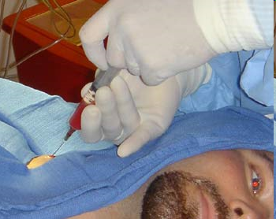
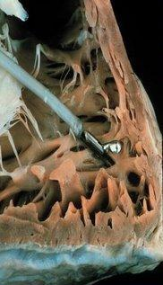
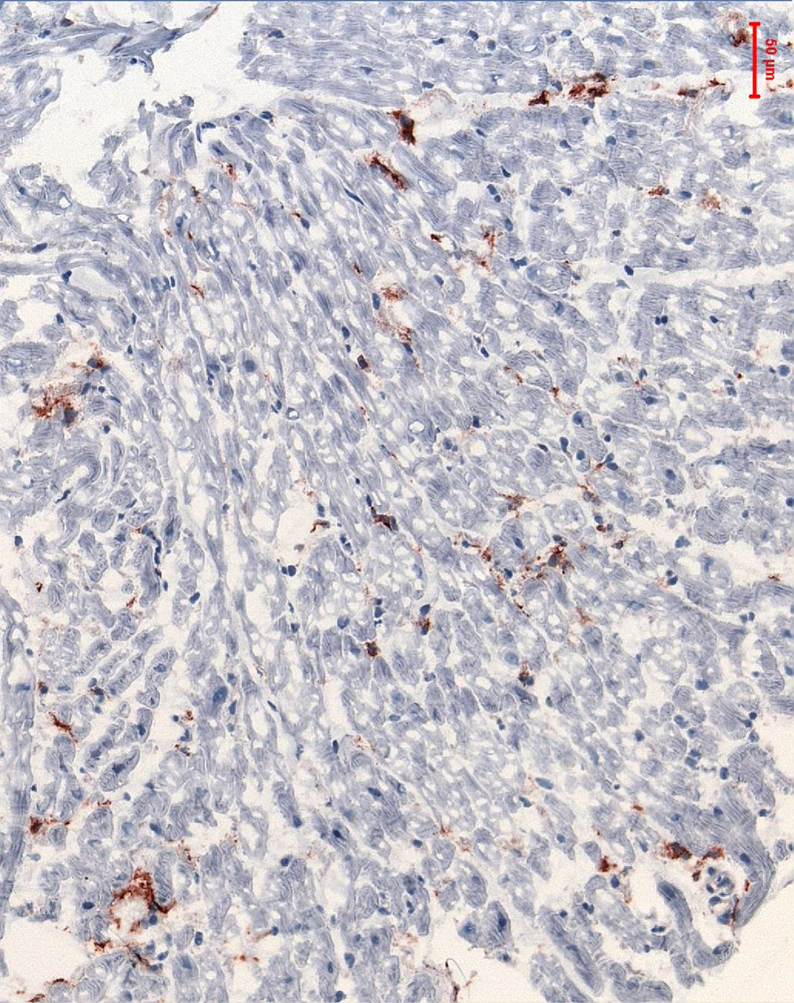
Cardiac biopsies (pathology/virology)
Inflammation: CD3, 4, 8, 45, -68/mm²
Viruses: PVB19, HHV4, HHV6, EV
Storage diseases
Cardiotoxicity
Fibrosis
Complication rate: 0,3 %
Notes:
To diagnose the viruses: one has to take biopsies.

Slide 35
Cardiomyopathies: genetics and second hit
Second hits: gene-environmental interactions
Hypertrophic cardiomyopathy
Arrhythmogenic cardiomyopathy
Dilated cardiomyopathy
  Case of peripartum CMP
  Case of myocarditis → CMP
  Case of auto-immune → CMP
Why me? Diagnosis!
ICD indication (LMNA, RBM20, PLN)
Family members: early diagnosis & treatment

Slide 36
Treatment of inherited DCM ?
Gene mutation: 30 % of familial, 15 % non-familial
  R/ based on molecular profile
  R/ gene therapy
    AAV- overexpression
    siRNA- gene silencing
    Crispr-Cas gene editing
Challenge:
  Cardiac (CMP) delivery
  Immune response
  Safety
TITIN tv 1 (responsers)
Other genetic
DCM
TITIN tv 2 (non-
Responders)
Lamin A/C
Stroeks S. Genet Med. 2021 Nov;23(11):2186-2193
Notes:
Genetic counseling and testing is therefore recomended in all patients with both acquired or familal dilated cardiomyopathies

Slide 37
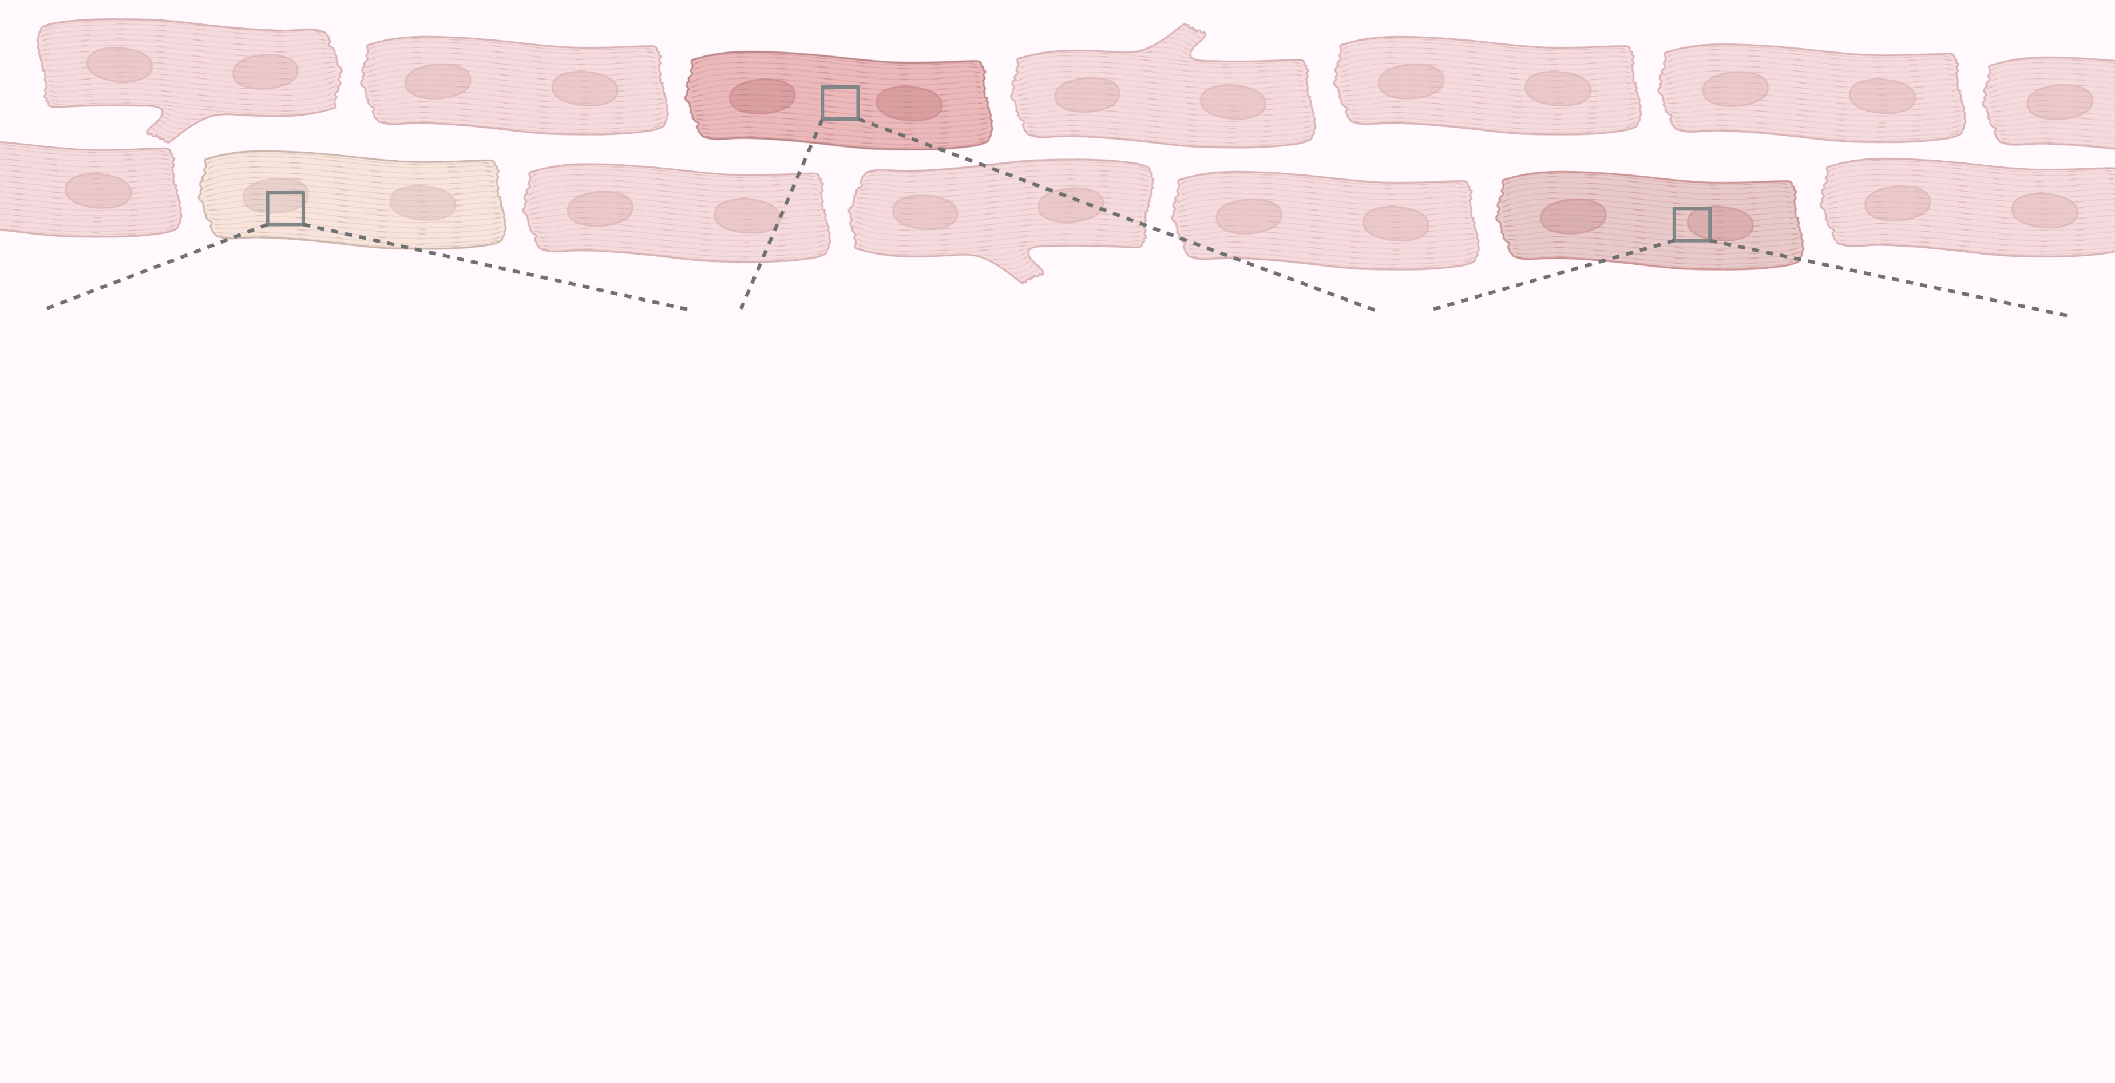
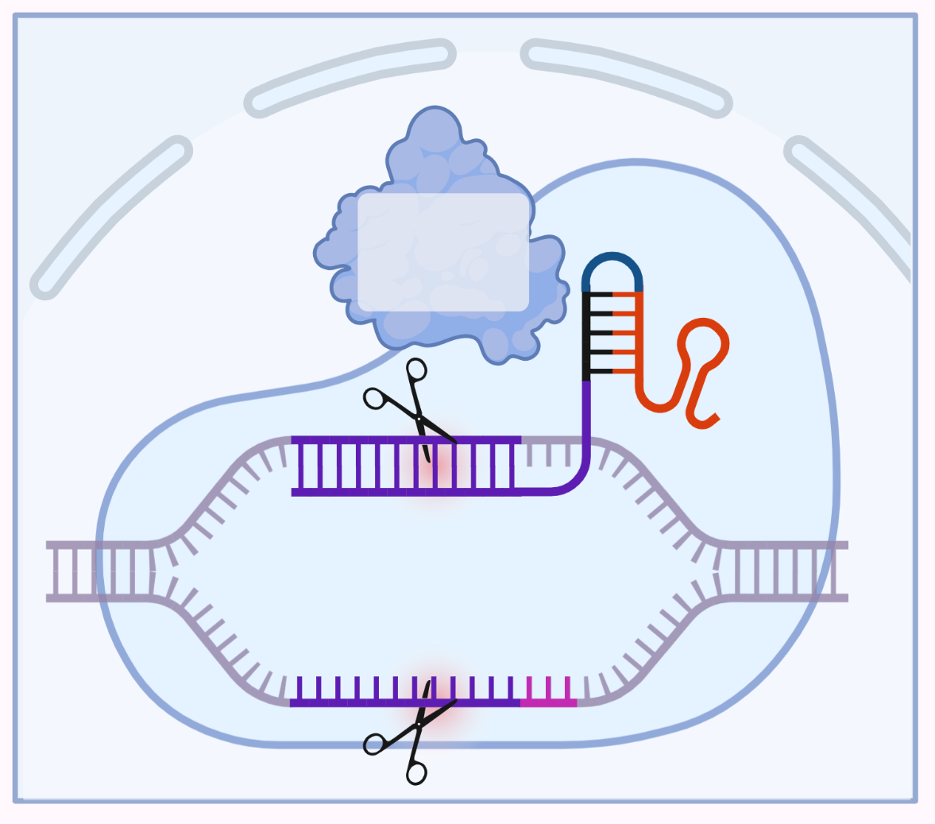
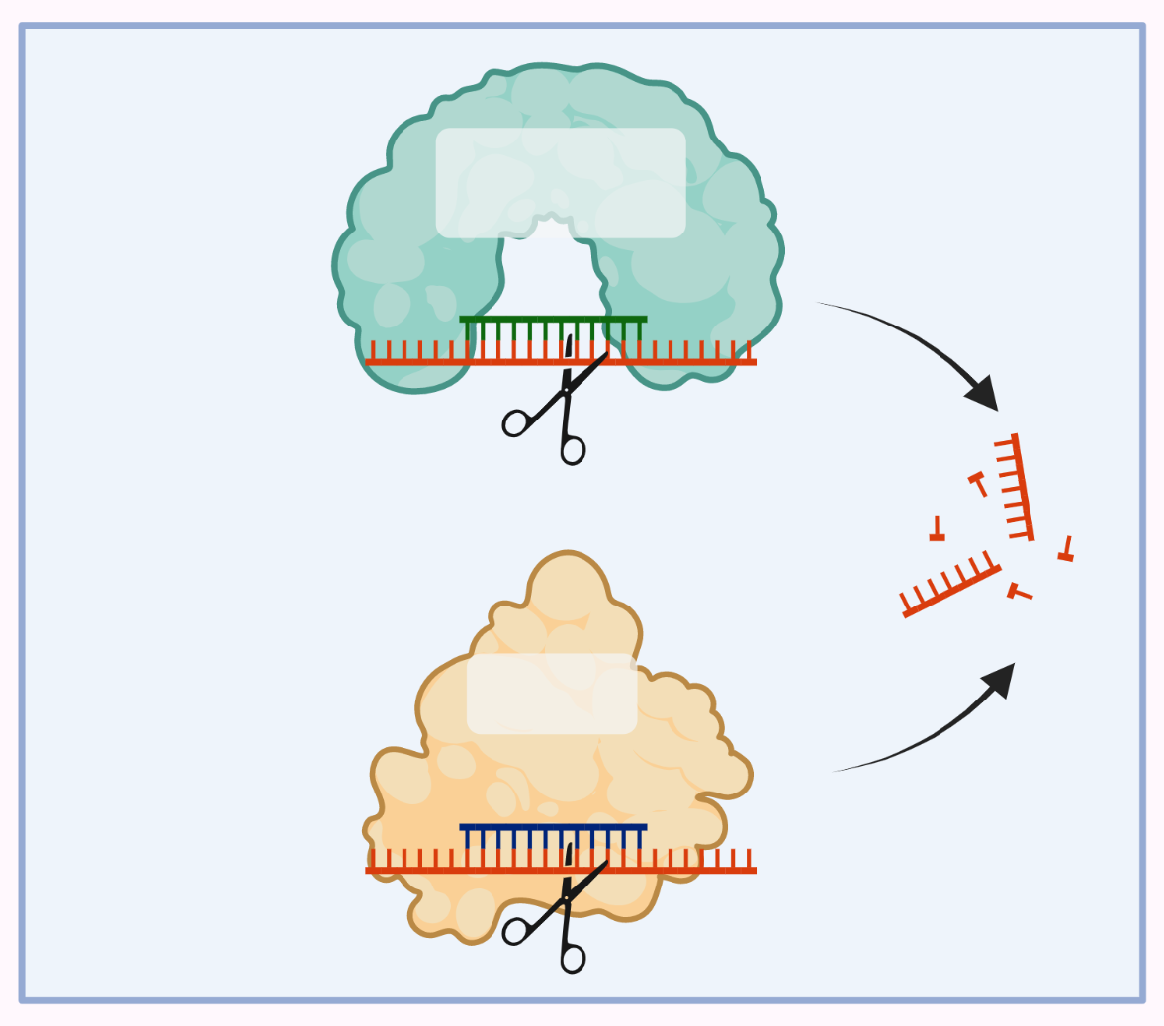
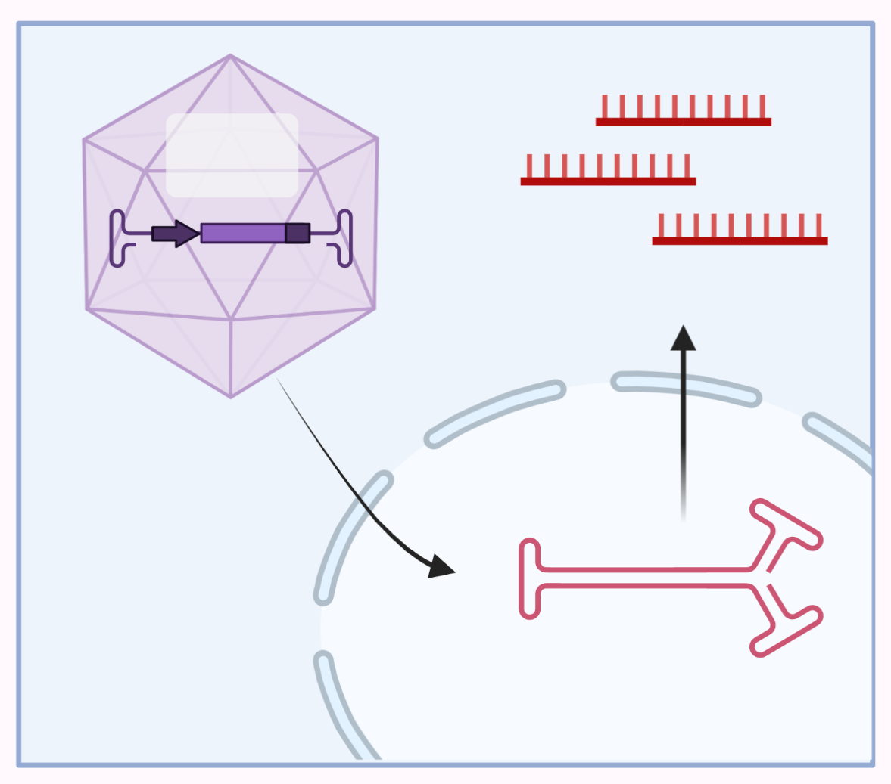
RNase-H
AAV
CRISPR-Cas9
ASO
Mutant
PLN mRNA
LAMP2 mRNA
DCM associated gene
RISC
siRNA
Uncoated AAV
Mutant mRNA
Gene correction:
normal gene expression
Gene suppression:
↓ poisonous gene expression
Gene overexpression:
↑ healthy gene expression
Heymans et al., Lancet, 2023 Sep 16;402(10406):998-1011

Slide 38
Conclusions, cardiomyopathies
Gene mutations in up to 30 % of DCM, 50 % in HCM, 70 % in ACM
  Titin truncating variants in 1/3 of mono-genic DCM, 10 % of all DCM
  Second hit/ disease modifiers!
Acquired CMP: look for genetics!
  Second hits:
    Acquired (toxic, co-morbidities, chemotherapy, arrhythmias)
    Disease modifiers: pregnancy, hypertension, diabetes,…
Gene mutation → oxidative stress & metabolic alterations → inflammation/fibrosis -→ worse outcome.

Slide 39
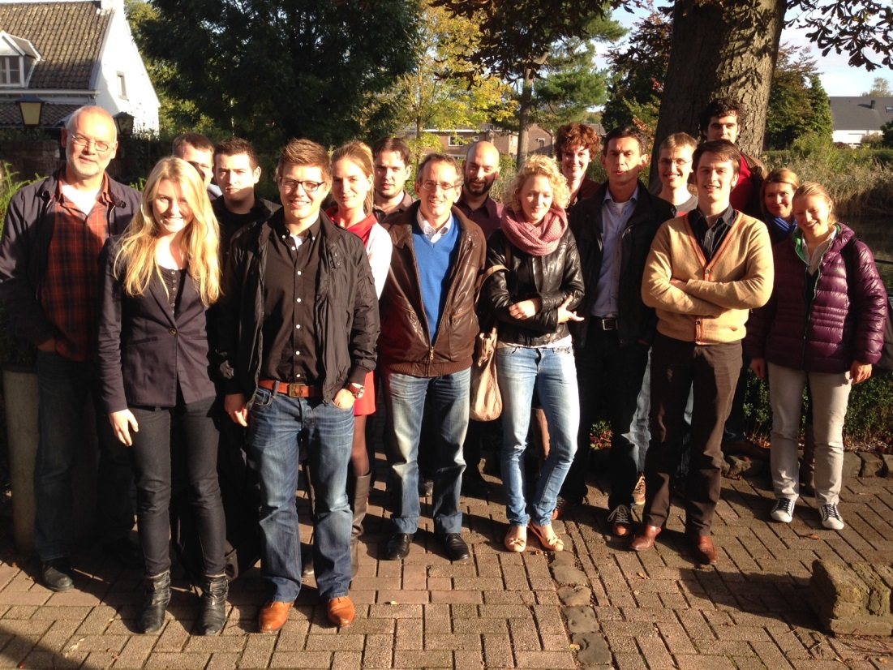





Acknowledgements
Cardiogenetics, Maastricht
- H. Brunner
- I. Krapels
- E. Vanhoutte
- A. van den Wijngaard
Leuven University
-E. Jones
- J. Raman
-S. Simons
Boston
N. Lakdawala
University Hospital Maastricht,
Dep. of Cardiology,
www.hfresearch.eu
  HP Brunner Larocca
  C. Knackstedt
  L. Jones
  V. van Empel
  P. van Paassen
  A. Raafs
  M. Sikking
  S. Stroeks
  M. Henkens
  M. Hazebroek
  J. Verdonschot
  B. Nihant
  M. Minten
  R. Van Leeuwen
  W. Verhesen
  L. Paas
Trieste
M. Merlo
Amsterdam
J. Beulens
C. Bezzina
J. van der Velden
Rotterdam
D. Duncker
J. van de Wouw
Utrecht
H. den Ruijter
G. Valstar
F. Asselberg
London
S. Prasad
J. Ware
F. Marelli-Berg
Berlin, Germany
C. Tschoeppe
S. Van Linthout
Berlin
N. Huebner
ARENA-PRIME
Metacor
Horizon
IMI-CARDIATEAM

